Slide 1
Say Gay
Student Health & Human Services
Office of Human Relations, Diversity & Equity
June 2022

Slide 2
Welcome
Who is your favorite fictional character?

Slide 3
Objectives
Learn about Florida’s 2022 "Don't Say Gay" bill
Review the rationale behind the bill
Reflect on the difference between the bill in Florida, and California's LGBTQ Ed Code protections

Slide 4
Don't Say Gay in Florida
On March 8, 2022, the Florida Senate passed the Parental Rights in Education bill, which was signed by Governor Ron DeSantis on March 28th.
The bill bans schools from discussing sexual orientation or gender identity in kindergarten through third grade.
As part of this bill, the Florida Department of Education is also banning Social Emotional Learning
Notes:
Source: https://www.foxnews.com/politics/florida-desantis-signs-parental-rights-education-bill
State targets teaching of critical race theory, social justice, emotional learning in social studies textbooks (fox35orlando.com)

Slide 5
Reflection
Do you recall if you received "classroom instruction" about sexual orientation or gender identity between kindergarten and third grade?

Slide 6
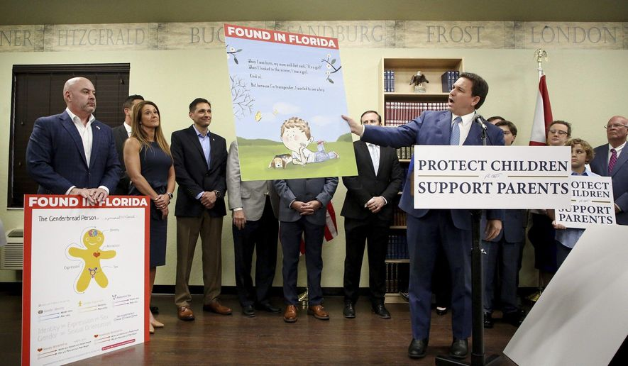
Parents Rights
The law is meant to give parents full control of determining if, when and how to discuss sexual orientation and gender identity with their children.
The bill gives parents an option to sue a school district if the policy is violated.
The law also requires school to secure parental approval for any health or support services offered to their kids in school.
Notes:
Read the slide aloud for the students.
Source: https://www.npr.org/2022/03/28/1089221657/dont-say-gay-florida-desantis
House Bill 1557 (2022) - The Florida Senate (flsenate.gov)

Slide 7
Protect the Children
DeSantis said it was "inappropriate" to teach kindergarten-aged kids that "They can be whatever they want to be."
At a Senate hearing on Feb. 8, Republican Sen. Travis Hutson gave the example of a math problem that includes the details that “Sally has two moms or Johnny has two dads.”
Republican State Sen. Dennis Baxley, who sponsors the bill in the Senate, said that is “exactly” what the bill aims to prevent.
Notes:
Source: https://www.npr.org/2022/03/28/1089221657/dont-say-gay-florida-desantis

Slide 8
Reflection
Do you believe there is harm in a math problem like:
Tommy has two moms...
Why or why not?

Slide 9
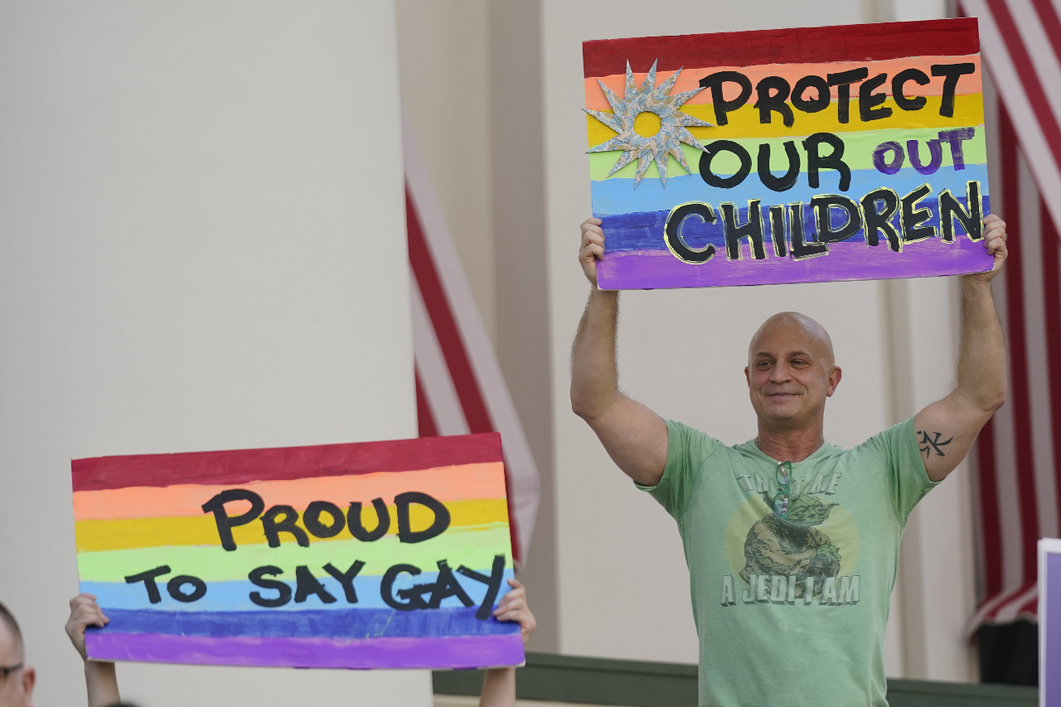
We Say Gay in California
The FAIR Education Act (CA Ed Code 51204.5)
The California Healthy Youth Act (CA Ed Code 51933)
School Success and Opportunity Act (CA Ed Code 221.5)
CA Department of Ed Legal Advisory regarding CA's antidiscrimination statutes to transgender youth in schools.
Notes:
Read the slide aloud for the students.
Source: https://www.npr.org/2022/03/28/1089221657/dont-say-gay-florida-desantis

Slide 10
The FAIR Education Act (CA Ed Code 51204.5) (Fair Accurate Inclusive & Respectful)
Educators must include contributions of groups previously excluded in the history of California and the United States
Includes men and women of numerous ethnic groups
Includes the contributions of LGBT Americans

Slide 11
The California Healthy Youth Act (CA Ed Code 51933)
Requires school districts to provide students with integrated, same sex and health education and HIV prevention education – at least 1x in high school and 1x in middle school.
All instruction and materials in K-12 must be inclusive of LGBTQ students.
Instruction shall affirmatively recognize that people have different sexual orientations, gender expression and gender identity.
Instruction must explore the harm of negative gender stereotypes.

Slide 12
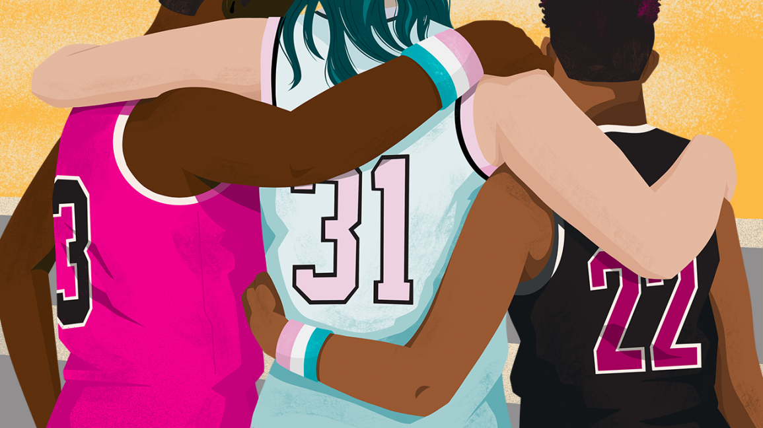
School Success and Opportunity Act (CA Ed Code 221.5)
Requires that pupils be permitted to participate in sex-segregated school programs, activities and use facilities consistent with their gender identity – regardless of what gender is listed on their student record.

Slide 13
Reflection
California and Florida laws are so different!
Share your thoughts.

Slide 14
Class President Can't Say Gay
The class president at a Florida high school wasn't allowed to share his experience as a gay student in his graduation speech or how the state's so-called "Don't Say Gay" law will affect students like him.
So he talked about something else that makes him a little different from his classmates -- his curly hair.
Notes:
Play the video for the students (7:00) https://www.youtube.com/watch?v=qpTVyozS7M0

Slide 15
Reflection
What do you think about the unique way this student expressed his concerns over Florida's "Don't Say Gay" legislation?

Slide 16
Check Out
What is your favorite color to wear?

Slide 17
Human Relations, Diversity & Equity
Notes:
https://achieve.lausd.net/human-relations
For your LD CONTACT: https://achieve.lausd.net/Page/17621

Slide 18
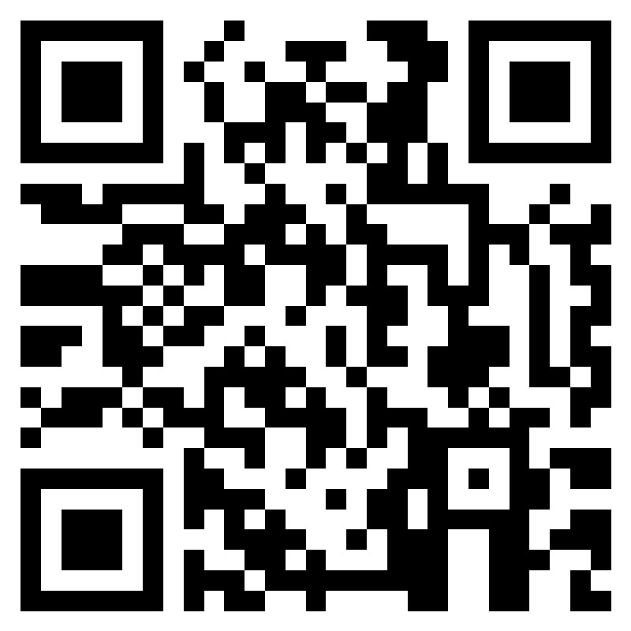
Teacher Feedback
Notes:
Teacher, please complete a brief feedback survey by scanning the QR code or using the link below
https://forms.office.com/r/i9UqyyxzTT

